Slide 1
Constraints
The prototype must:
Travel on the ground
Have a width not greater than 160 mm in its starting configuration (140mm is desirable)
Have a length not greater than 220 mm in its starting configuration (180mm is desirable)
Weigh less than 0.7 kg (0.5kg is desirable)
Comply with a $150 budget ($120 is desirable)
Use the supplied Arduino Uno controller
Use the Manufactured Component (Section 3.3) mounting plate your team will make;
Have no wireless data transfer to any external device
Have no physical connection to any external device (battery, laptop)
Have no sharp or otherwise dangerous parts
The chassis must not be 3D printed

Slide 2
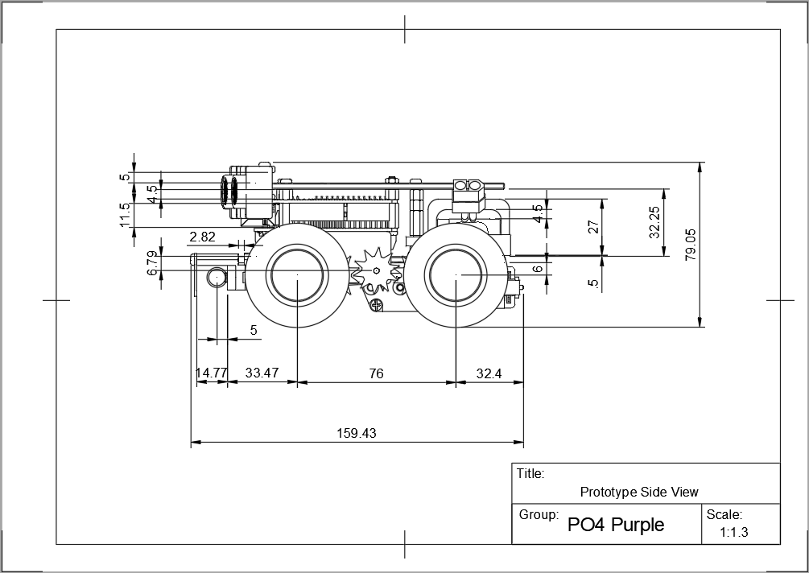

Slide 3
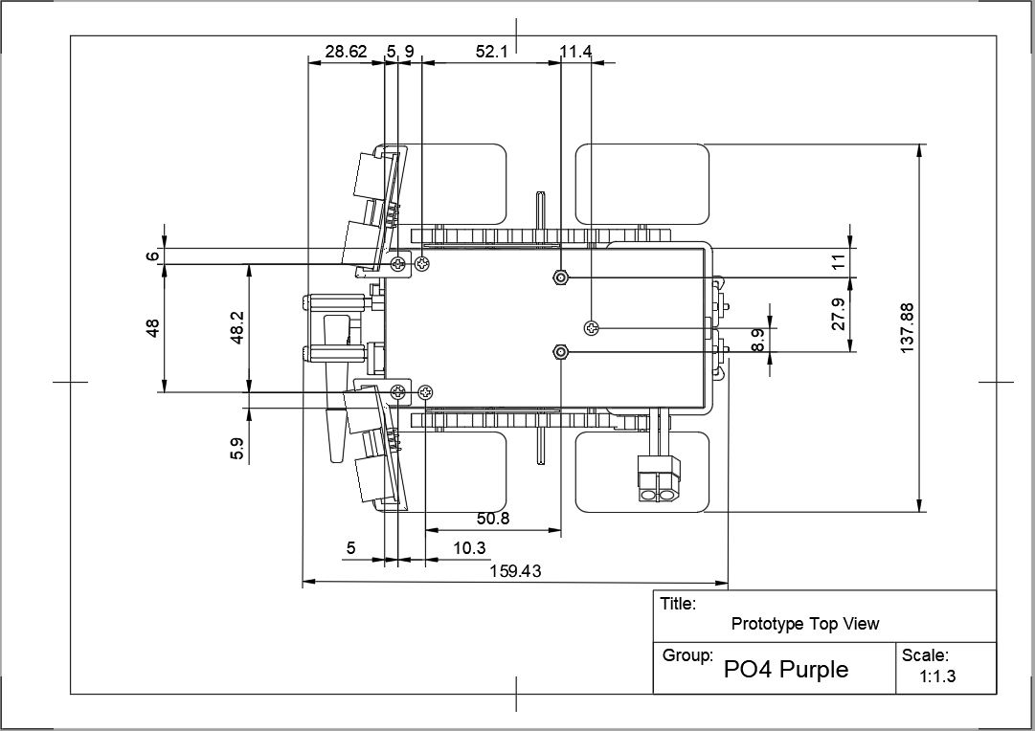

Slide 4
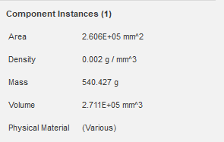
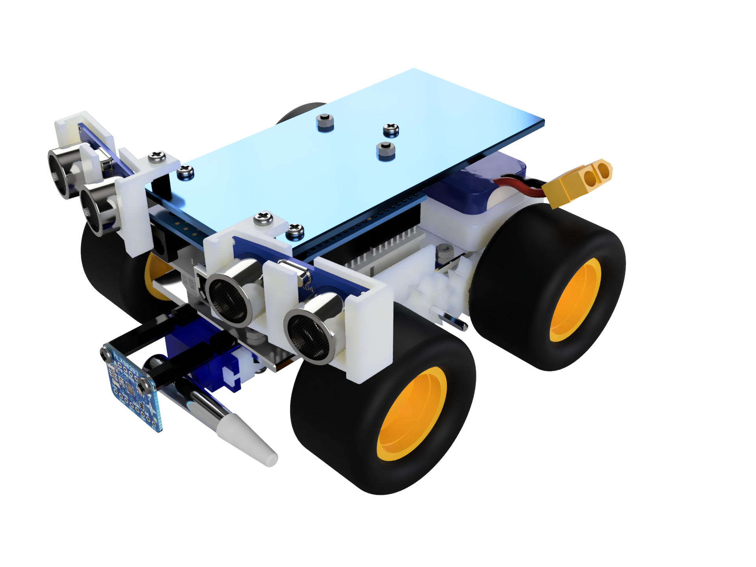
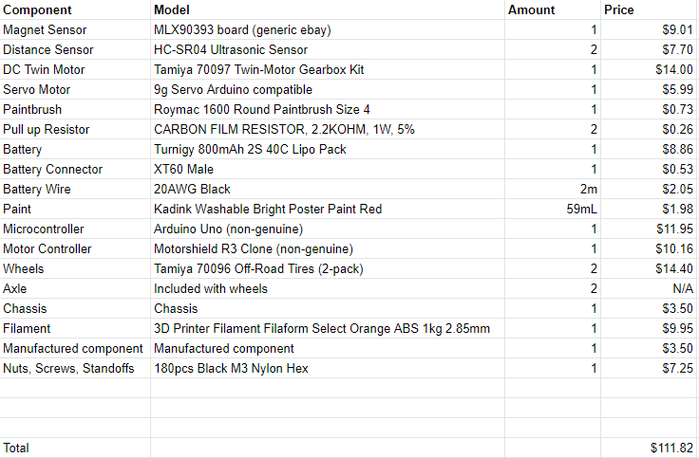

Slide 5
Centre of Mass
Length: 87mm (From front to back)
Height: 34mm (From bottom to top)
Width: 70mm (Front right to left)

Slide 6
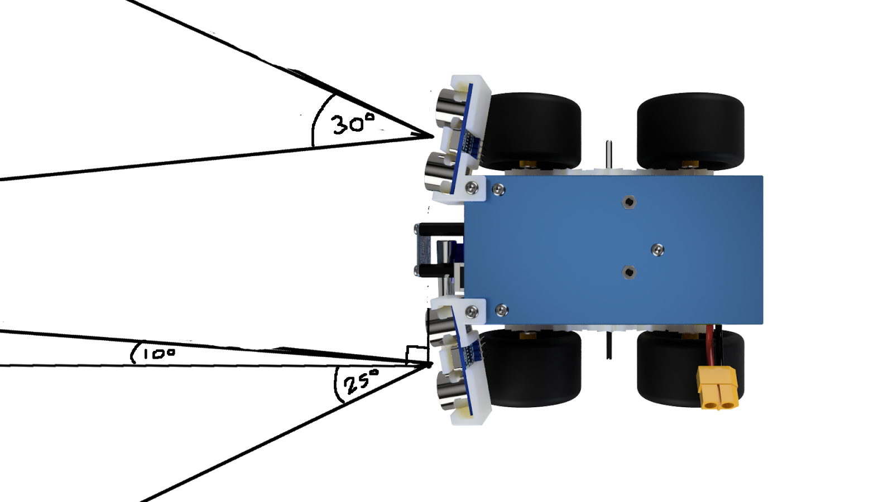

Slide 7
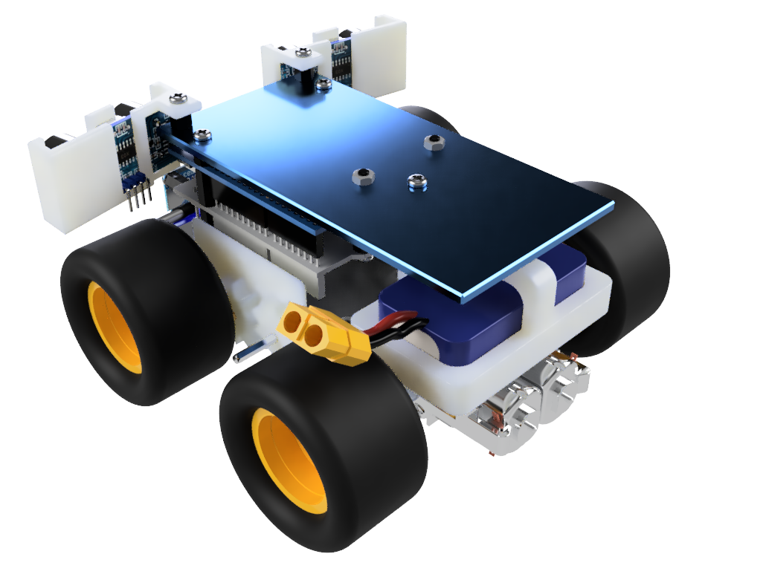

Slide 8
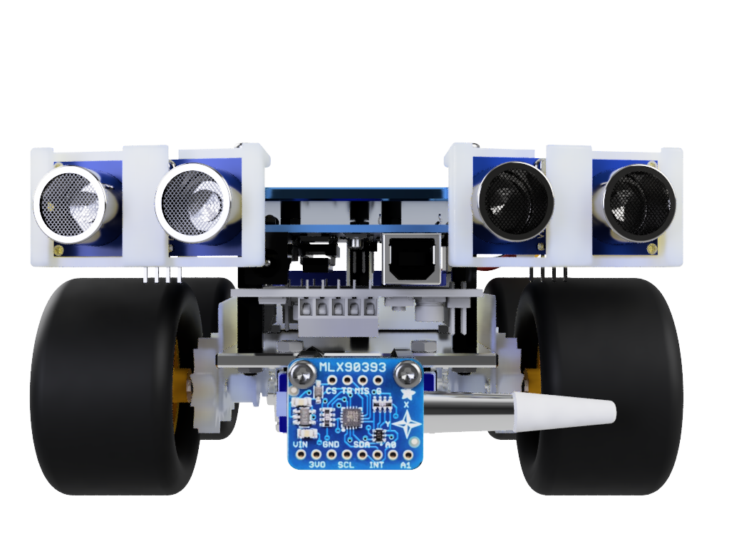

Slide 9
